Slide 1
Video 1 - non-animated, real footage
1.1 Define the Humane Society of Utah’s key principles and information.
Create an introductory video about key information
Founding date: 1960 (https://www.utahhumane.org/meet-us)
Mission and Vision
Mission: Dedicated to the elimination of pain, fear and suffering in all animals.
Vision: We believe in the benefits of responsible pet ownership for both people and their pets; and that our role is to bring them together, to keep them together, and to provide the best possible care for our animals while we diligently work to find them new loving homes.
Location of building
4242 South 300 West, Murray, Utah 84107
Funding
The Humane Society of Utah (HSU) is a local, private 501(c)3 nonprofit organization that relies on individual donations, grants, and fundraising to operate. We do not receive any tax dollars or government funding, and is not a branch of any local or national group.
Video content strategy
An aerial shot of the HSU building, with visuals of the old building, old inside of the building, and quick videos shots of the inside of the newly renovated HSU building. We will include our animated narrator/dog throughout that will supplement the videos/visuals with pre-scripted information and audio overlay.

Slide 2
HSU Logo
Shot of outside of the building (aerial/pan) - still of the groundbreaking photo
Quick shots of the animals at the HSU
Address on screen: 4242 South 300 West, Murray, Utah 84107
Lounge music with HSU logo fading in and out
Audio: founded in 1960, the Humane Society of Utah (HSU)
Audio: has fostered an atmosphere of love, compassion and respect for Utah’s pets and is dedicated to the elimination of pain, fear and suffering in all animals.
We are located just off the freeway in Murray, Utah—centrally located and accessible to the community in the Salt Lake Valley.
Video of kitty city, dawgville, and tiny town.
Photo of the cat that was adopted after 300+ days (text on screen, name/days at HSU)
Collage of animals
For more information on donating visit www.utahumane.com
Audio: HSU believes in the benefits of responsible pet ownership for both people and their pets; and that our role is to bring them together, to keep them together, and to provide the best possible care for our animals while we diligently work to find them new loving homes.
There is no set limit on the length of time an adoptable pet may remain in our adoption program, and we have many lifesaving programs and services to help not only our shelter animals but pets in the community as well.
We receive over 11,000 animals each year and provide lifesaving programs and services to move each individual animal to their most appropriate outcome as quickly as possible.
The Humane Society of Utah (HSU) is a local, private nonprofit organization that relies on individual donations, grants and fundraising to operate. We do not receive any federal, state or government funding.
(https://secure3.convio.net/hsutah/site/Donation2?1400.donation=form1&df_id=1400&mfc_pref=T&_ga=2.211079125.1768772090.1549826670-266459427.1547773917)

Slide 3
Show plaque(s)
Collage of animal photos that fade into HSU logo (like the 55 year celebration video) to close video out???
This is all made possible through the voluntary donations of individuals, businesses, and foundations.
Music

Slide 4
Video 2 - animated
Create an introductory video about the Humane Society of Utah vs other similar organizations
Local organization vs Worldwide
HSU vs BFF Society
HSU vs Humane Society of America
HSU vs Animal Control
HSU vs Animal Services
Video content strategy: initial list of similar organizations, visuals of each organization, with information from our animated narrator/dog throughout that will supplement the videos/visuals with pre-scripted information and audio overlay.

Slide 5
HSU Logo
American Map with pins of the all the Humane Society of Utah
Venn Diagram of the similarities and differences of the HSU and HSUS
Map of Utah with pins of all the local organizations
Lounge music with HSU logo fading in and out
HSU is a local, private nonprofit organization and is not a branch of any national organization. Although many animal welfare organizations are working toward similar goals, there are some differences. We’re here to help Utah’s helpless and homeless pets and advocate for legislation on a local level.
Audio: What are the differences between HSU and HSUS? HSU has a local clinic and animal shelter. We work on Utah legislation and local cruelty investigations for companion animals. HSUS is not a shelter and works with animal rescue and welfare for all animals on a national level.
There are many city or county municipal shelters, private shelters, humane societies, and nonprofit animal rescue groups.
Venn Diagram of similarities and differences of HSU and other like organizations
Continue differences
For more information, please visit www.utahhumane.com.
Continue differences
To Contrast HSU and other similar organizations.
HSU is open admissions,
accepts owner-surrendered pets,
has in-house clinic,
and is 501(c)3.
Others may be
Closed admissions
No owner surrendered pets
May NOT have clinics
Funded by taxes or other government funding
[Differences between HSU and Animal control and animal services cont.]
HSU only accepts companion animals, others may accept strays, wildlife, and livestock
Animal control accepts strays, HSU does not
HSU cannot take an animal from the field and does not have law enforcement ability.
Generally spe your local animal control services agency is charged with protecting you from animals, responding to a dog running at large or barking too much, dealing with vicious dog bites or attacks, licensing your pet, and sheltering your pet if it were lost. Most animal control agencies are also responsible for deceased animals in your neighborhood
Music
Notes:
Humane Society of USA, PETA, ASPCA, Best Friends Animal Society, c: While all of these organizations work to help all kinds of animals, what sets HSU apart from the national organizations is that we operate a local, private nonprofit open-admission shelter that receives and houses animals through a trackable adoption program. HSU works directly with members of our Utah communities to find homes for homeless pets, advocate for animal welfare legislation, stop abuse and neglect, and inform the public about pet care training. HSU handles local companion animal issues while some other national organizations may work with all animals on a national and international level.
Generally speaking, your local animal control services agency is charged with protecting you from animals,
responding to a dog running at large or barking too much, dealing with vicious dog bites or attacks,
licensing your pet, and sheltering your pet if it were lost. Most animal control agencies are also responsible for deceased animals in your yard, road or neighborhood.

Slide 6
Collage of animal photos that fade into HSU logo (like the 55 year celebration video) to close video out???
Music

Slide 7
Video 3 - animated
Create a video explaining the HSU admissions process.
Explain coordinated entry and pet retention
Explain no-kill initiative
Video content strategy: We will discuss each point individually with minimal on-screen text, supported with visuals (e.g. no kill certification badge), supplemented with pre-scripted information and audio overlay from our animated narrator/dog throughout.

Slide 8
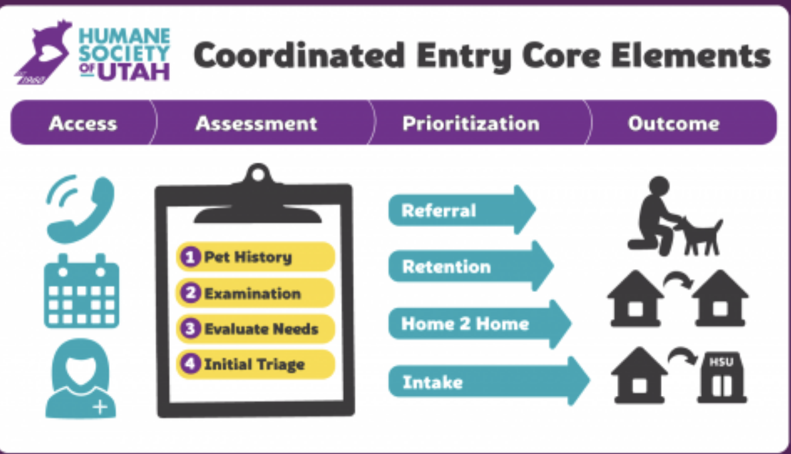
HSU Logo/Title page with Hobbes
Show CES graphic.
Show outside of Admissions entrance.
Show a horse, goat or feral cat.
The HSU works with our community to find the best possible solution for both owners and their pets. HSU believes in quickly finding the right outcome for every pet who comes to us, even if that “outcome” is never being admitted at all. Our goal is to keep a pet and owner together whenever possible through our Pet Retention PRogram.
HSU is Utah's largest private open-admission shelter, meaning that our doors are always open to any animal that we can legally accept. We accept owner-surrendered companion animals. We cannot legally accept stray animals or animals found at large, which are the responsibility of your municipal animal shelter and should be taken to the local animal control services for the area where the animal was found.
Please note, we are not suited to accommodate livestock, wildlife, or pets such as reptiles, fish or exotic animals. HSU does not accept healthy feral or stray cats for intake and recommends local Community Cat Programs. Read Pet Rehoming FAQs on our website for more information.
Music with logo fading in and out
Show cat in Kitty City villa with window perch.
Show kittens.
Show dog in kennel.
But what about the 10%?
As a member of the No Kill Utah (NKUT) Coalition, the Humane Society of Utah does not limit the time that a pet can stay with us until it finds a new home.
According to the national standard, no-kill does not mean euthanasia. It is defined as a 90% placement or live release rate, which HSU has exceeded for both dogs and cats.
Best Friends defines the term “kill” as ending the life of a healthy or treatable pet, whereas “euthanasia” is defined as an act of mercy...
Euthanizing a pet is considered only when veterinary or behavioral experts determine that an animal’s condition is untreatable, and the animal has little or no chance of an acceptable quality of life.
If no-kill means 90% placement or live release rate, what about the other 10%?...
No-kill standards outline that a dog or cat will not be euthanized for space, financial restrictions or time, but understands that up to 10% of the animals a shelter receives may be suffering and require euthansia.
Notes:
Best Friends defines the term “kill” as ending the life of a healthy or treatable pet, whereas “euthanasia” is defined as an act of mercy. Euthanizing a pet is considered only when veterinary or behavioral experts determine that an animal’s condition is untreatable, and the animal has little or no chance of an acceptable quality of life.

Slide 9
Show someone loving pet.
For more information please visit the website at www.utahhumane.com
Collage of animal photos that fade into HSU logo (like the 55 year celebration video) to close video out???
For pets whose suffering can’t be remedied any other way, euthanasia will be available with the most kindness and comfort that can possibly be provided. HSU euthanizes animals by injection (EBI) only for irremediable health or behavior issues when necessary, and does not take lightly the decision to end a life.
Music

Slide 10
Video 4 - animated
Create a video about frequently, frequently asked questions of the Humane Society of Utah.
Mnemonic strategies (chunking and grouping) to describe the following:
Frequently, frequently asked questions
Where do your animals come from?
How do I adopt an animal from the HSU?
How do I report animal neglect or cruelty?
I found a lost/stray animal. What should I do?
How can I help/make a donation?
Is HSU a no-kill shelter?
Video content strategy: short worded list of FAQs (listed above), then we will discuss each point individually with minimal on-screen text, supported with visuals (e.g. no kill certification badge), supplemented with pre-scripted information and audio overlay from our animated narrator/dog throughout.

Slide 11
HSU Logo/Title page with Hobbes
Question pop ups
Volunteer with customer with graduation caps/light bulbs appear on head
[slide 4] Question 1: Where do your animals come from?
Would you know how to respond if a customer asked you the following questions?
I found a lost dog, can I bring it to you?
Here at the HSU, our goal is to provide quality customer service and information to everyone. It is important to be aware of the most frequently asked questions and how to appropriately reply.
HSU accepts owner-surrendered pets. We do not take animals from the field or accept strays, which is the responsibility of your local animal control services...
We also receive over 3,000 at-risk animals from other local shelters and surrounding Western states...
...giving these animals a second chance.
Music with logo fading in and out
Question 2: How do I adopt a pet from HSU?
Question 3: How do I report a case of abuse or neglect?
What should I do if I find a lost or stray pet? What should I do if I have lost my pet?
How can I make a donation to HSU’s lifesaving programs?
HSU has an open-adoption process and encourages you to visit our website at utahhumane.org/adopt for more information...
View all our available animals on our website, then bring the entire family down to meet them. You’ll be able to speak with an adoption counselor to find the best fit for you and the pet. Animals are adopted on a first come, first served basis; we cannot hold an animal.
HSU does not have law enforcement authority...
If you have information about animal abuse or neglect, please contact your local animal control services.
HSU cannot legally accept a stray pet. They need to be taken to the local animal control services for the area in which they were found. The local facility will hold the pet for five days so owner and pet can be reunited. …
If you have lost a pet, visit your local animal control facility, call surrounding shelters and vet clinics, and post flyers in your neighborhood and on social media. More tips can be found on our website at utahhumane.org/lostpets.
As a local, private nonprofit organization, we rely on physical and monetary donations to function. You can make a donation in person, by mail, or over the phone. You can also donate on our website and view physical items needed on our Donation Wish List…
The Humane Society of Utah is dedicated to being transparent and accountable with our financial documents. We are in good standing with the IRS and nationally recognized nonprofit standard organizations, such as Guidestar, Charity Navigator and the Better Business Bureau.

Slide 12
Is HSU a no-kill shelter?
HSU is an open-admissions, private nonprofit organization that has exceeded no-kill standards. This means we admit any companion animal that we can legally accept….
We receive no tax dollars from federal, state, or local government funding, nor are we a chapter of any national organization…
“No-kill” does not mean no euthanasia. The term “kill” means ending the life of a healthy or treatable pet. Euthanasia is considered mercy for an animal suffering from an irreparable condition…
HSU has exceeded the national no-kill standard of a 90% live-release rate. HSU will not euthanize a healthy or adoptable pet.

Slide 13
Video 5 - animated
Create a video about services/programs provided by the Humane Society of Utah
Services:
Spaying and Neutering
Microchip
Adoption
Vaccination
Euthanasia
Programs:
Pet retention
Transfer program
Foster care program
Humane education program
Volunteer program
Video content strategy: initial on-screen list of services (listed above), then we will discuss each service individually with minimal on-screen text, supported with visuals—especially ones of the HSU building and where inside the building these services take place (e.g. spay/neuter), and supplemented with pre-scripted information and audio overlay from our animated narrator/dog throughout.
Notes:
HSU’s in-house Clinic offers vaccinations, spay/neuter surgeries, microchips, heartworm tests (including heartworm preventative medication), anal gland expression, nail clipping, and owner-requested euthanasia of sick and elderly pets.

Slide 14

HSU Logo
Zoom in/out from Kitty City/inside of building to show building as a whole showing clinic, foster dept, etc.
What services are offered at the clinic? Photo of actual clinic.
Music with logo fading in and out
The HSU is best known for helping animals find loving homes. But, on a day-to-day basis, we do much more than that.
As a friend of HSU, you have the opportunity to educate the community on how they can take advantage of accessible, affordable care for their pets—before and after adoption.
The HSU has an in-house clinic that offers affordable vaccination and spay/neuter services to the community while doing even more for our shelter pets.
Photos/icons alongside labels of services provided (e.g. chip, stethoscope, nail clippers, etc.)
What are the programs offered at the HSU?
Blurb about each program alongside photos/icons. (eg: Humane education program has volunteers speaking to a crowd with graduation caps appearing)
Balance scale? with services and programs. Happy face.
Services
Programs
Spaying and neutering, microchipping, adoptions, vaccinations, and end of life euthanasia are all offered at HSU.
Foster Care, Behavior and Training, Volunteering, Pet Retention, Humane Education, Transfer, Fundraising and Development
Pet retention - keep pets and owners together whenever possible
Transfer program - brings in other at-risk pets from partner shelters to be adopted
Foster care program - provide care for young, ill, injured or shy pets in a home until adoptable
Humane education program - educate children on pet care and animal welfare
Behavior & Training - offer classes and enrichment
Volunteer program - help HSU function
Development - to continue to expand and improve lifesaving services and programs through fundraising
So whether you need to vaccinate your pet or learn about how to volunteer HSU is the place to be.
Notes:
Pet retention - keep pets and owners together whenever possible
Transfer program - brings in other at-risk pets from partner shelters to be adopted
Foster care program - provide care for young, ill, injured or shy pets in a home until adoptable
Humane education program - educate children on pet care and animal welfare
Behavior & Training - offer classes and enrichment
Volunteer program - help HSU function
Development - to continue to expand and improve lifesaving services and programs through fundraising

Slide 15
For more information please visit the website at www.utahhumane.com
Collage of animal photos that fade into HSU logo (like the 55 year celebration video) to close video out???
Music

